Slide 1

SecureEdgeAI Local AI Assistant
AI for Small Businesses
Privacy-First, Fully Customizable LLM Assistant

Slide 2

Problem & Opportunity
AI adoption is hindered by data privacy concerns.
Small businesses lack technical expertise for LLMs.
Current AI tools are generic and cloud-dependent.

Slide 3
Problem Statement
Most AI tools require internet and transmit user data.
Subscription-based pricing is a barrier to adoption.
Small businesses need secure and cost-effective alternatives.
Lack of domain customization limits AI usefulness.

Slide 4
Solution Overview
LOCAL AI ASSISTANT runs entirely local.
Built with Open WebUI, Ollama, and Qwen3.
Includes industry-specific prompt templates.
Deployed on user hardware with full support.

Slide 5
Key Features
Runs entirely local, no internet required.
Supports 4-bit quantized models for low-end hardware.
Industry-specific prompt profiles and workflows.
User-friendly drag-and-drop interface.

Slide 6
Target Audience
Small business owners needing AI-driven automation.
Industry professionals seeking localized AI.
Non-technical users preferring plug-and-play solutions.
Examples: tutors, agencies, restaurants, legal offices.

Slide 7

Tools and Models Used
LLMs: LlaMA3, Qwen3-7B for light tasks, Qwen3-11B for advanced needs.
Quantization: 4-bit for memory-efficient performance.
Interface: Open WebUI for interactive local use.
Inference Engine: Ollama optimized for CPU/GPU.

Slide 8
Data Handling Strategy
Client-provided data for fine-tuning (contracts, lessons, etc.).
Python scripts for tasks like CSV analytics, batch summarizations
Synthetic or public datasets for demo/training.
No cloud dependency—ensures full data ownership.

Slide 9
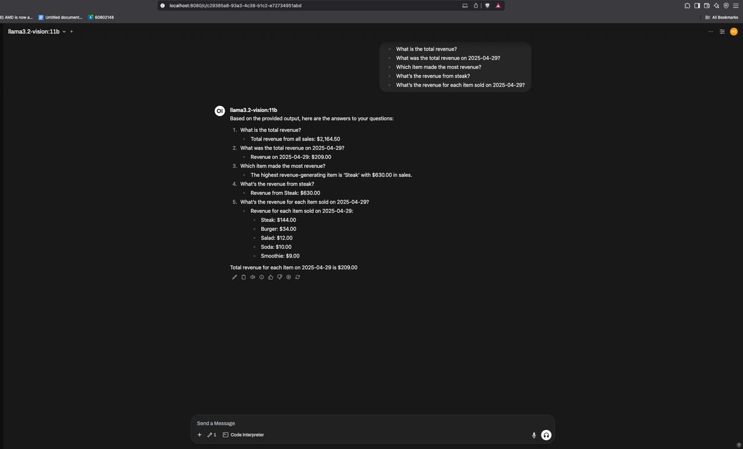
Figure: Revenue Analysis with LLaMA Vision
AI assistant analyzing business data and generating a
revenue dashboard.

Slide 10
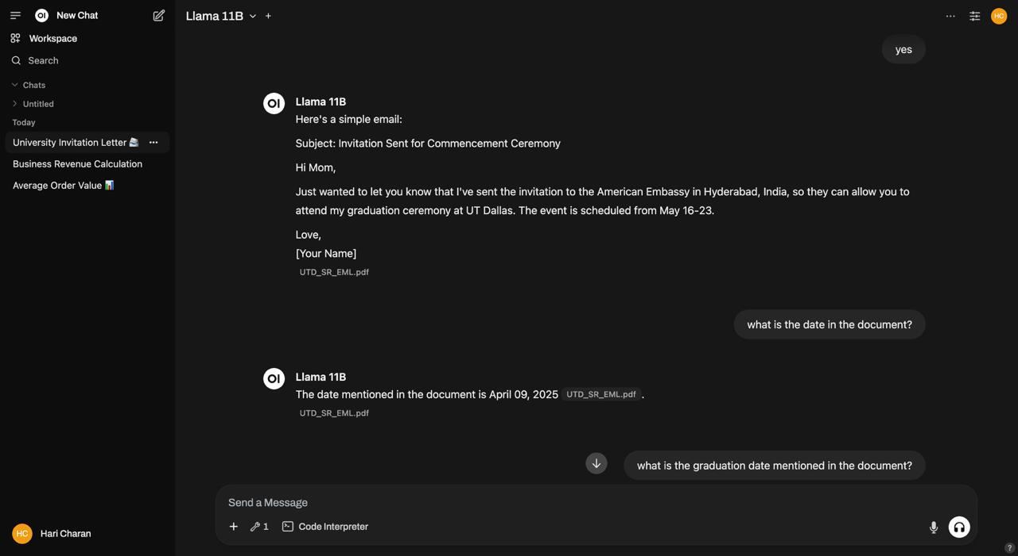
Figure: Personalized Email Drafting
LOCALAIASSISTANT creates a customized email based on
uploaded document context.

Slide 11
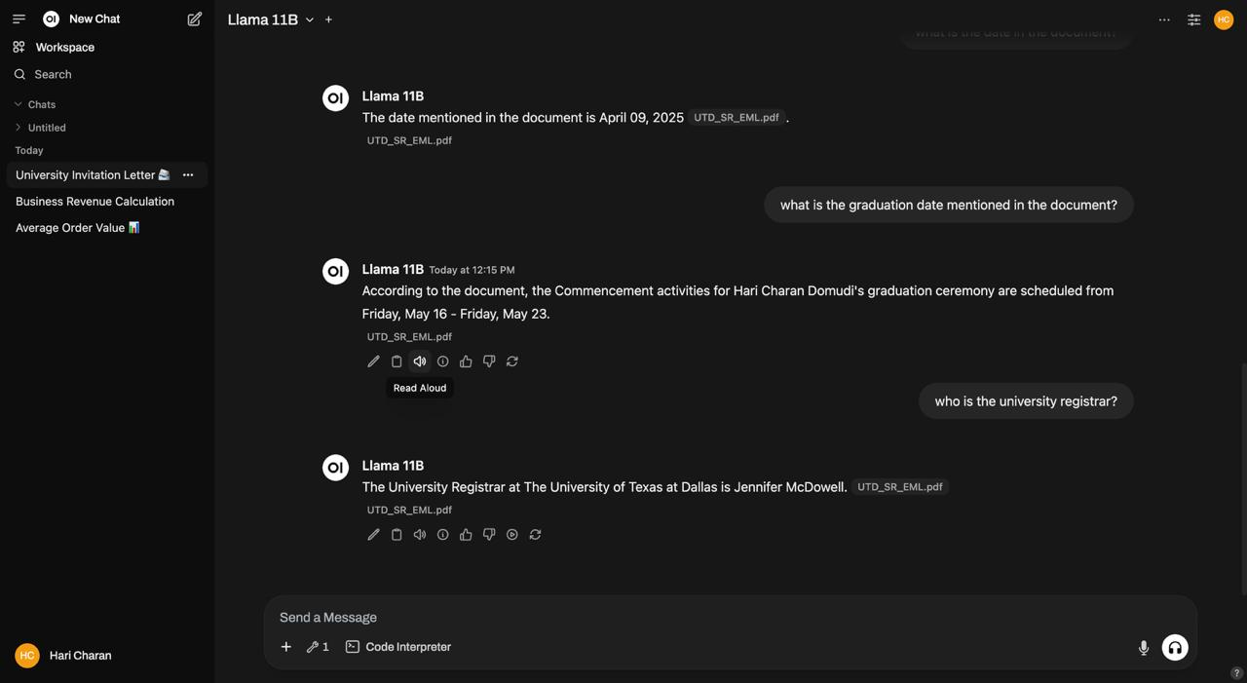
Figure: Follow-Up Queries from Uploaded Document
Assistant responds to queries and extracts specific data like
dates and names.

Slide 12
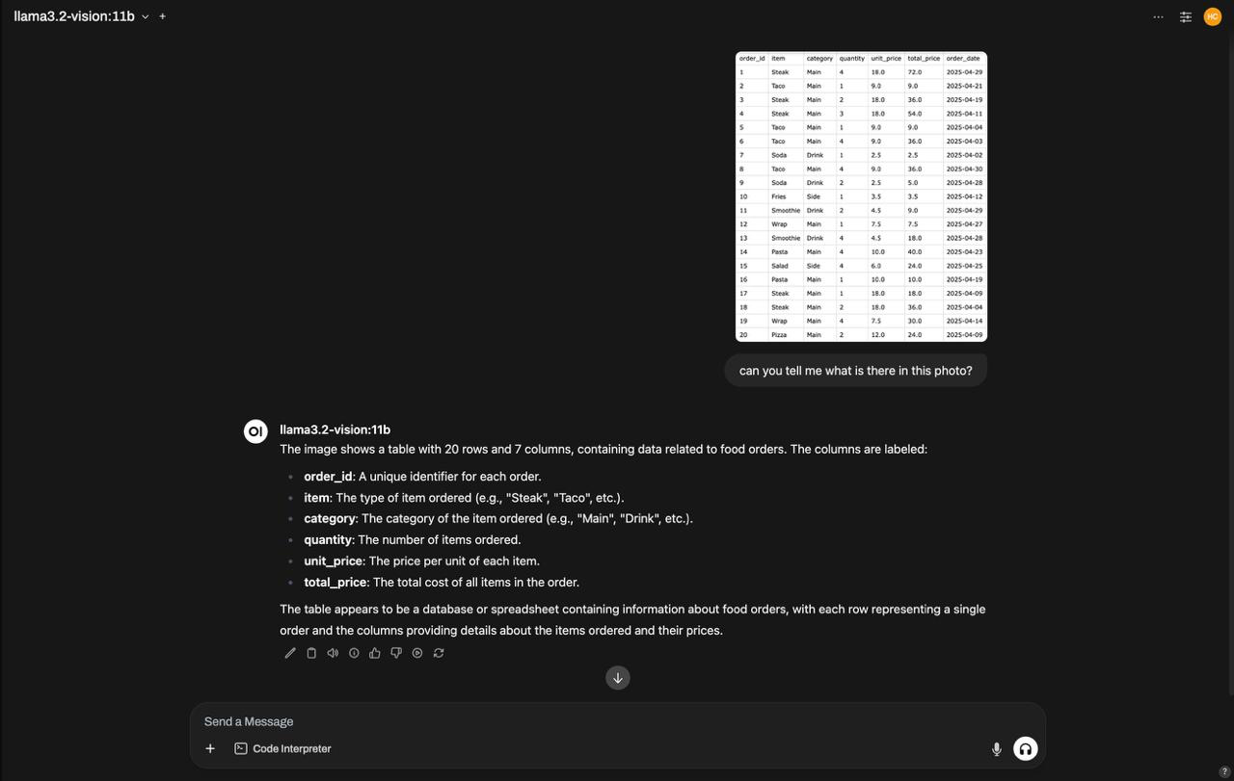
Figure: Converting Images to Structured Data
AI analyzes an image (e.g., receipt or table) and transforms it
into structured data.

Slide 13
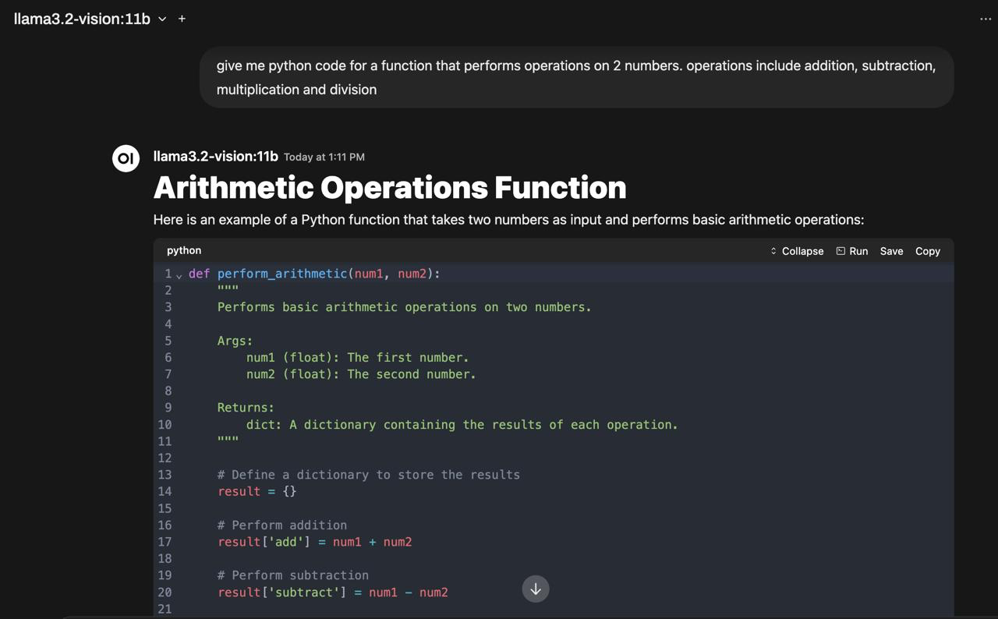
Figure: Python Code Generation for Automation
Assistant generates Python scripts for tasks like educational
exercises or business automation.

Slide 14

Concerns & Mitigation
Limited technical skills: Offer setup and tutorials.
Hardware limits: Use quantized models.
Data security: Full-disk encryption & secure caching.
Scope creep: Tiered pricing with clear deliverables.

Slide 15
Plan Tiers
Starter ($499): 2-3models, 10 Custom prompts, CSV analysis.
Growth ($999): >10 Templates, Analytics, Dashboards, Fine tuning models.
Add-ons: Backup scripts, encryption tools, custom UI.

Slide 16
Market Strategy
Free pilots for select local businesses.
Partnerships with hardware vendors.
Marketing through LinkedIn/YouTube with demos.
Low-cost entry and pay-as-you-scale model.

Slide 17
Unique Differentiators
Fully local and self-contained AI stack.
No Subscription—one-time setup and support plans.
Custom templates and domain-specific workflows.
Seamless integration with client’s existing data.

Slide 18
Why Local AI Assistant over cloud-base AI?
LOCAL AI ASSISTANT is not a generic chatbot.
We provide full setup, training, and ongoing support.
More secure and private than cloud alternatives.
Custom-built for each client’s unique needs.

Slide 19
Market Forecast
Year 1: 20 SP, 5 GP clients → $15K revenue.
Year 2: 50 SP, 20 GP clients → $45K+ via partners.
Year 3: 100 SP, 40 GP clients → $90K+ revenue.
Steady growth expected as privacy demand increases.

Slide 20
Scalability Challenges
Need trained staff for installs across clients.
Managing model versions on different systems.
Educating clients about benefits of local AI.
Segmented pricing for different business types.

Slide 21
Closing & Q&A
LOCAL AI ASSISTANT bridges AI access and privacy.
No cloud, no subscriptions, full data control.
Ready for deployment across multiple industries.
Questions & feedback welcome!

